Slide 1


Slide 2

HELLO
my name is Andy

Slide 3

Web Developer
Youth Worker
Gadget Guy
Parent of two
(Profession)
(Passion)
(Play)
(Practice)

Slide 4
What do we mean by
Social Media?

Slide 5
“Social media are computer-mediated technologies that allow the creating and sharing of information, ideas, career interests and other forms of expression via virtual communities and networks.”
Source: Wikipedia

Slide 6
Virtual communities and networks designed to share and receive content socially with friends and family, as well as people we don’t know.
These communities may be available through any internet-connected device such as a phone, iPod Touch, tablet, computer, gaming console or smart TV.

Slide 7
Social Media we are
going to focus on today

Slide 8


Slide 9
Instagram
Snapchat
Facebook
YouTube

Slide 10

Instagram
Snapchat
Facebook
+Messenger
YouTube

Slide 11

Instagram
Snapchat
Facebook
+Messenger
YouTube
Twitter
Periscope
Pinterest
Houseparty
WhatsApp
Skype
Texting

Slide 12

Instagram

Slide 13

Snapchat

Slide 14

Facebook

Slide 15

Facebook

Slide 16

YouTube

Slide 17

YouTube

Slide 18
Instagram
Snapchat
Facebook
+Messenger
YouTube
Twitter
Periscope
Pinterest
Houseparty
WhatsApp
Skype
Texting

Slide 19

The good, the bad,
and the ugly

Slide 20
What are some of the
benefits of Social Media?

Slide 21

Benefits of Social Media?
Connecting with people

Slide 22

Connect with people you can’t connect with in person

Slide 23
Benefits of Social Media?
Connecting with people
Outlet for creativity
Opportunity to have a positive impact on others
Opportunity to be encouraged by others
Provides some entertainment

Slide 24
What are some of the
challenges of Social Media?

Slide 25

Challenges of Social Media?
Exposure to inappropriate content
Exposure to inappropriate people
Exposure to inappropriate ideas/worldviews
Bullying, group bullying
Time consumption (addictive, replacement of good)
continued…

Slide 26
Challenges of Social Media?
Need to feel liked, cool, beautiful or sexy
Self-worth based on popularity
People knowing too much about them
Don’t know how to socialize in real life
Skewed view of reality

Slide 27
What types of
content can be shared?

Slide 28
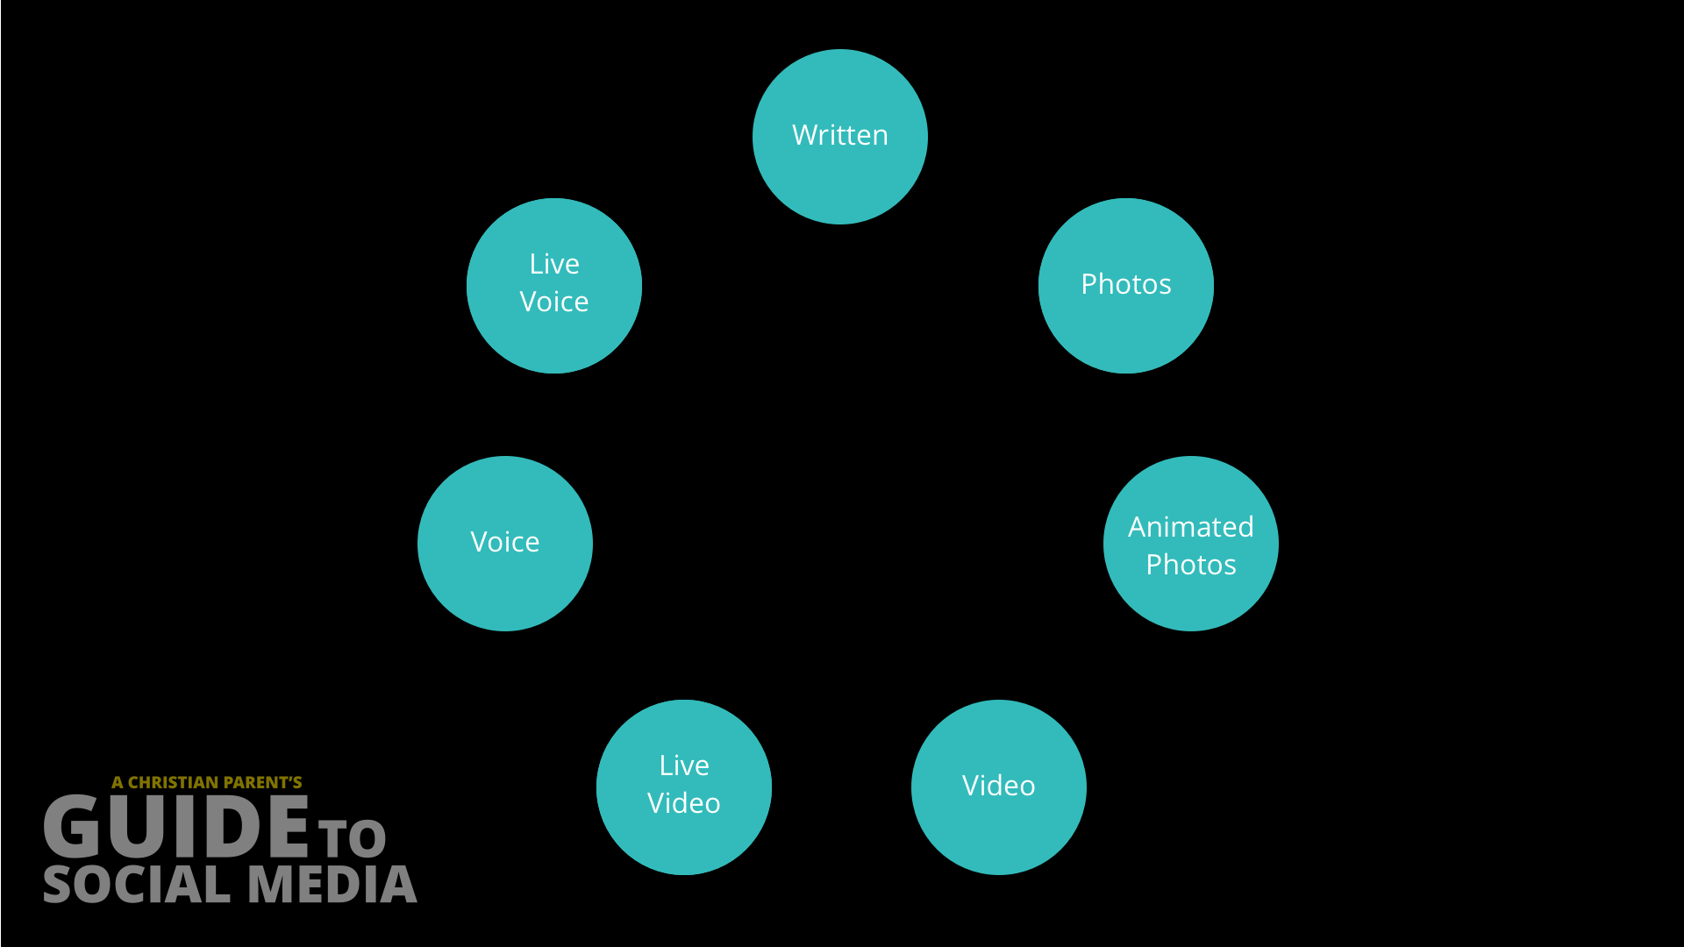
Types of
Content

Slide 29
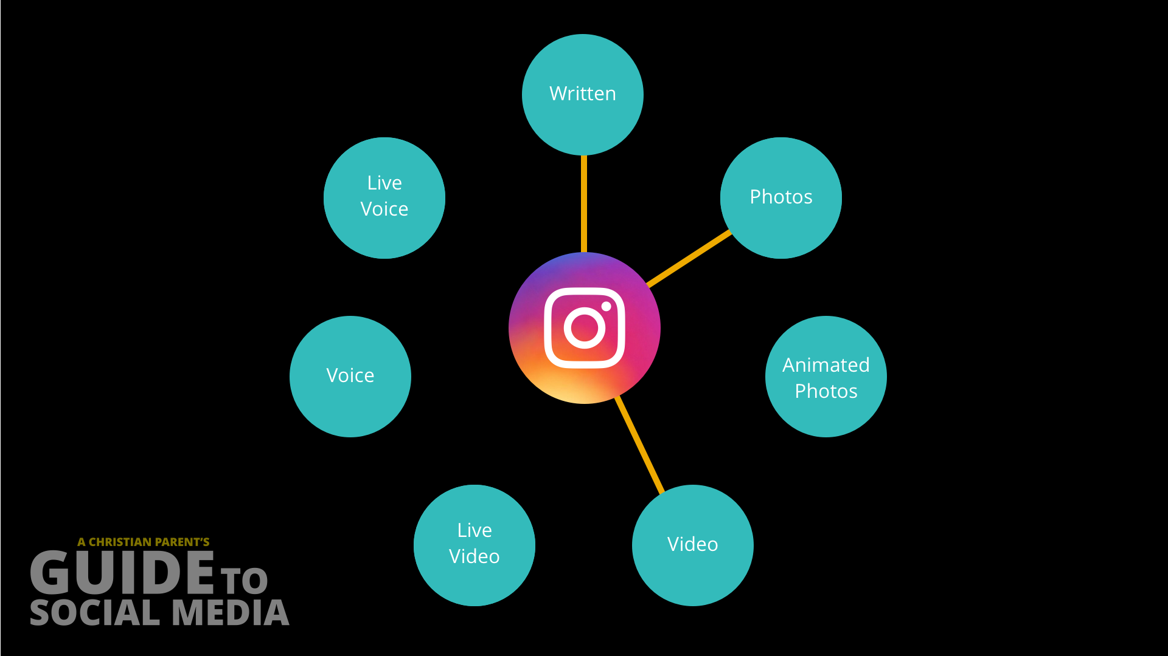
Types of
Content

Slide 30
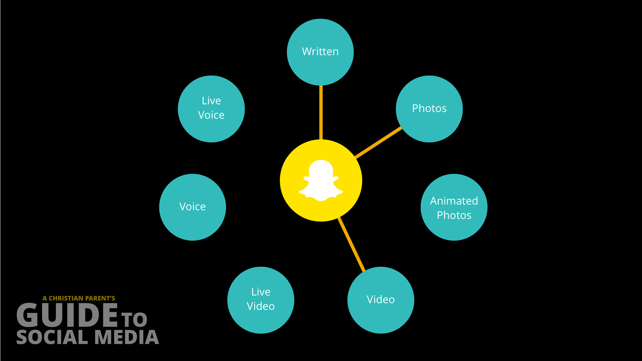
Types of
Content

Slide 31
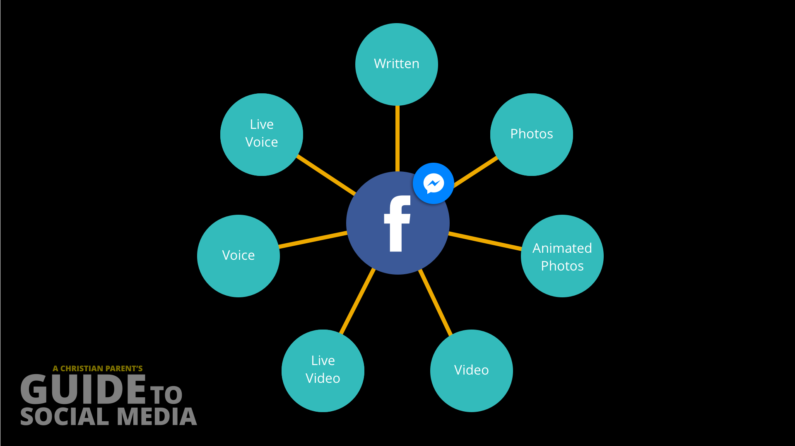
Types of
Content

Slide 32
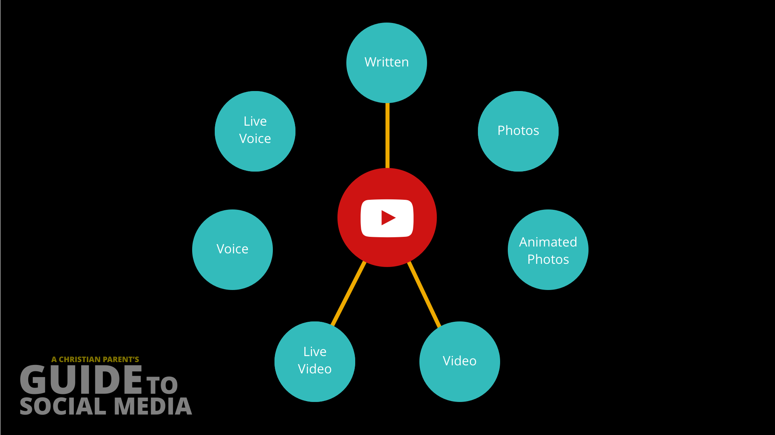
Types of
Content

Slide 33
What types of content can be shared?
 | Written | Photos | Animated Photos | Video | Live Video | Voice | Live Voice
Facebook | X | X | X | X | X | X | X
Instagram | X | X |  | X
Snapchat | X | X |  | X
YouTube | X |  |  | X | X |  | X
Twitter | X | X | X | X
Periscope | X |  |  |  | X |  | X
Pintrerest | X | X
Houseparty | X |  |  |  | X
Texting | X | X | X | X
FaceTime | X |  |  |  | X | X | X
WhatsApp | X | X | X | X | X | X | X
Duo |  |  |  |  | X |  | X
Skype | X |  |  |  | X | X | X
Hangouts | X |  |  |  | X | X | X

Slide 34
What ways can you
share content?

Slide 35
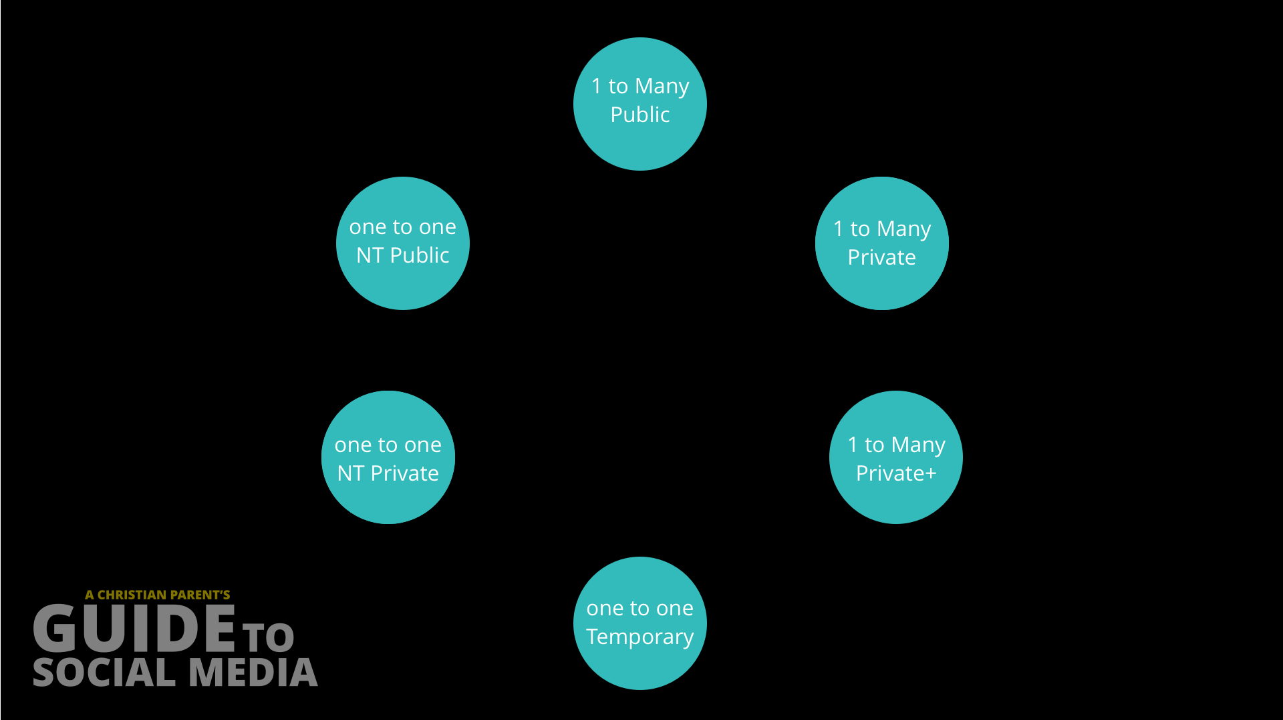
Sharing
Content

Slide 36
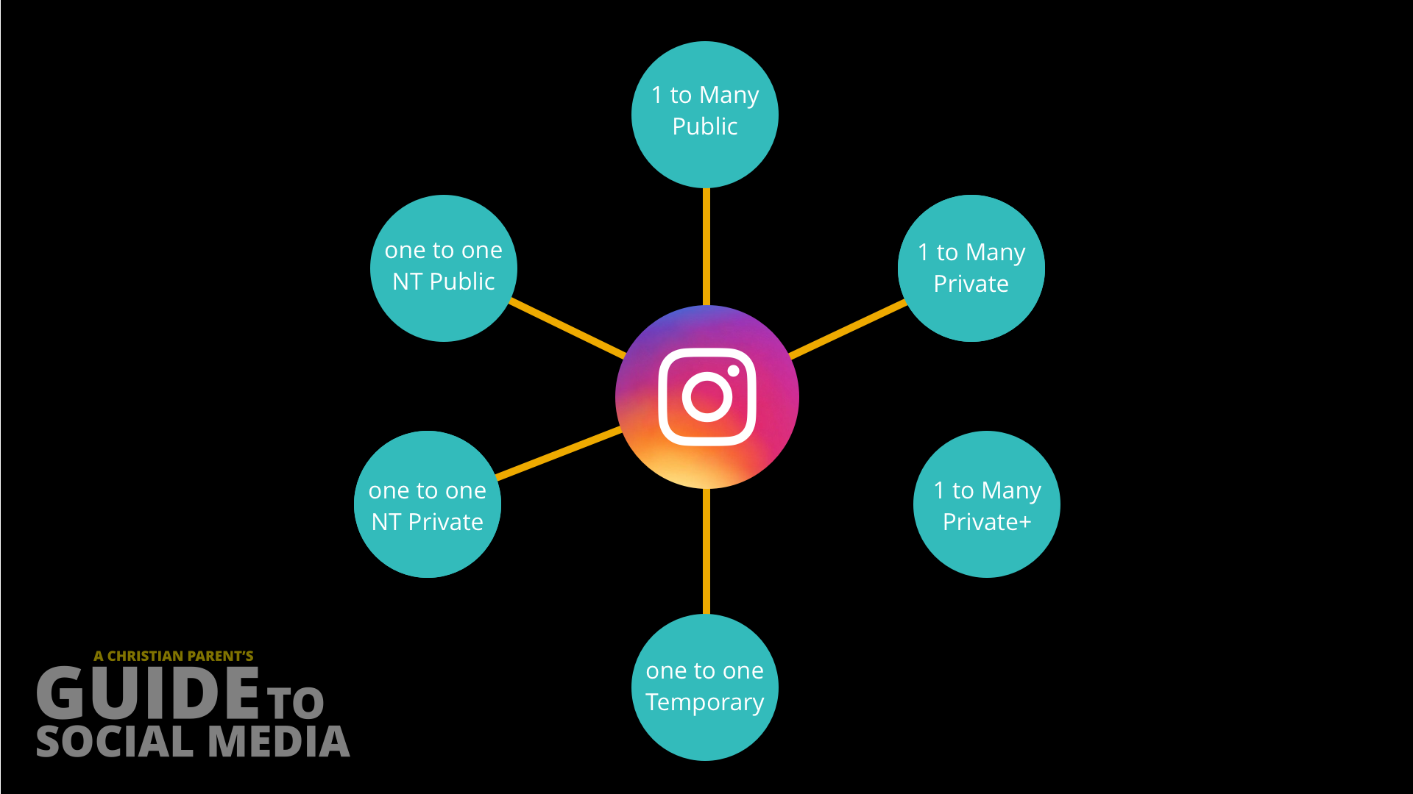
Sharing
Content

Slide 37
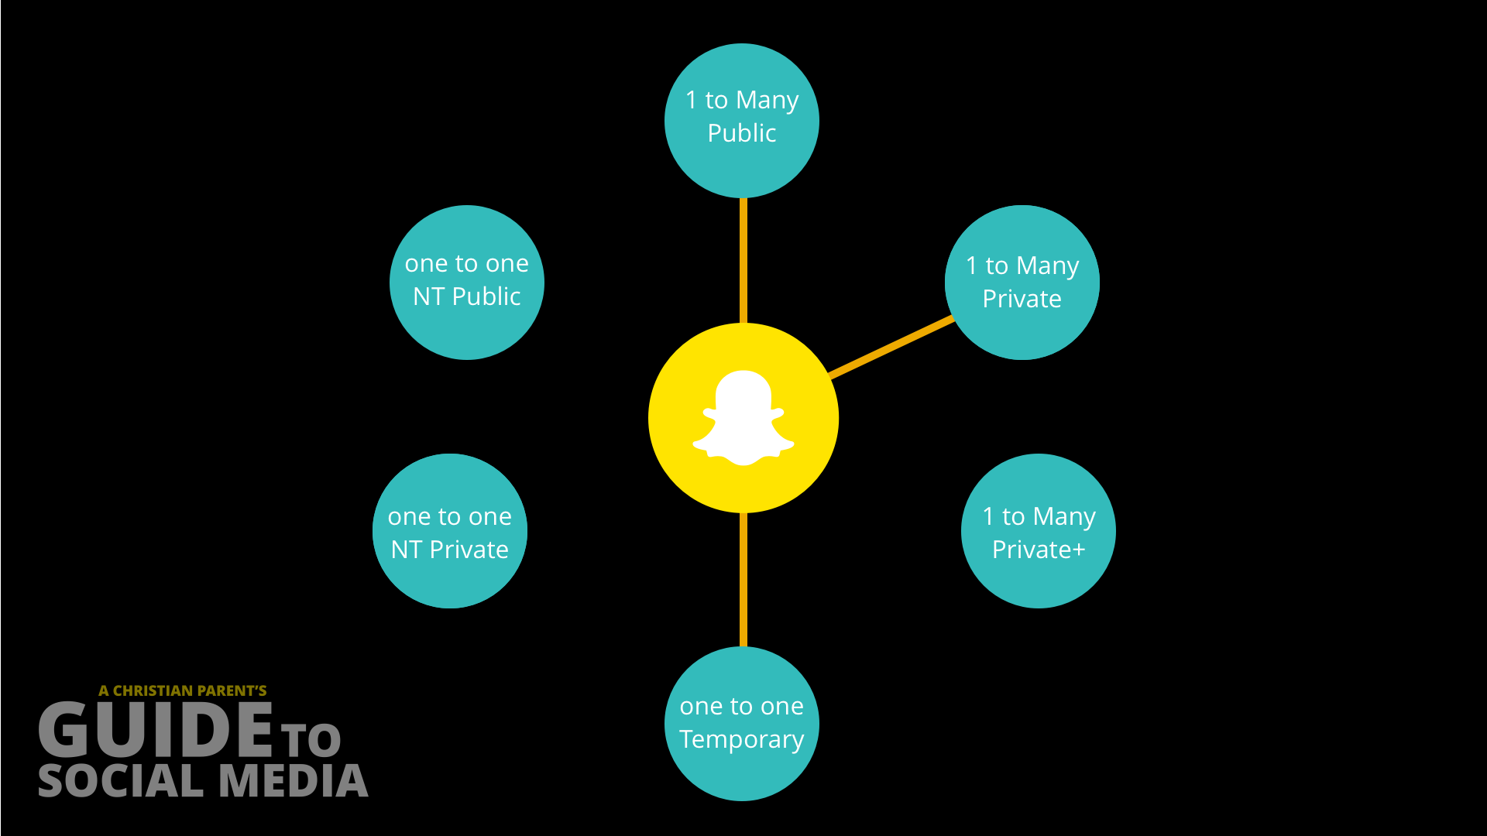
Sharing
Content

Slide 38
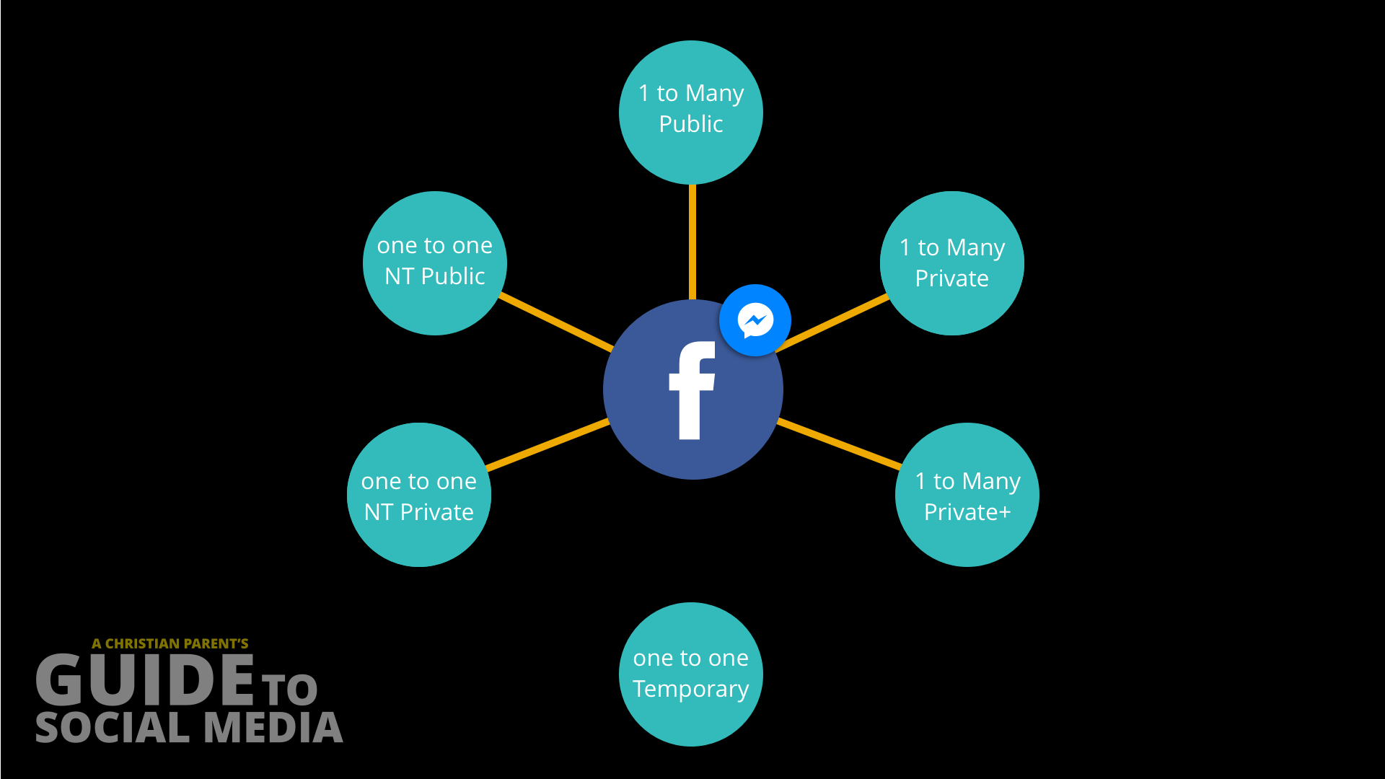
Sharing
Content

Slide 39
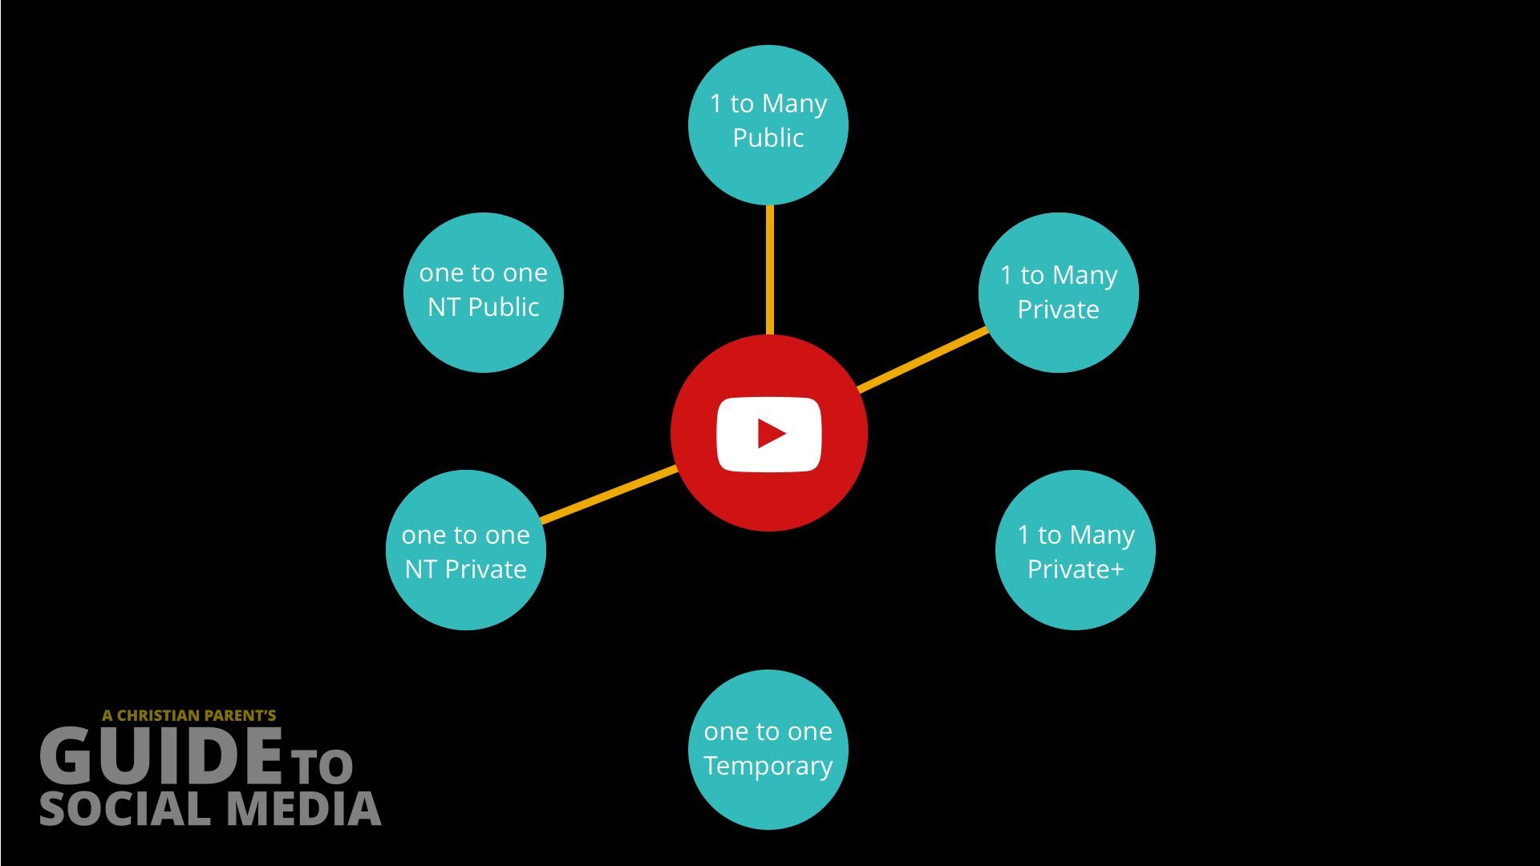
Sharing
Content

Slide 40
What ways can you share content?
 | Ways to share content |  |  |  | 1 - 1 NON-TEMP
 | 1 - # PUB | 1 - # PRI | 1 - # PRI+ | 1 - 1 TEMP | PRI NET | PUB NET
Facebook | X | X | X |  | X | X
Instagram | X | X |  | X | X | X
Snapchat | X | X |  | X
YouTube | X | X |  |  | X
Twitter | X | X |  |  | X | X
Periscope | X | X
Pintrerest | X | X |  |  | X
Houseparty |  | X |  | X
Texting |  | X |  |  | X
FaceTime |  |  |  |  | X
WhatsApp |  | X |  |  | X
Duo |  |  |  |  | X
Skype |  | X |  |  | X
Hangouts | X | X |  |  | X

Slide 41
What ways can you
receive content?

Slide 42

Receiving
Content

Slide 43
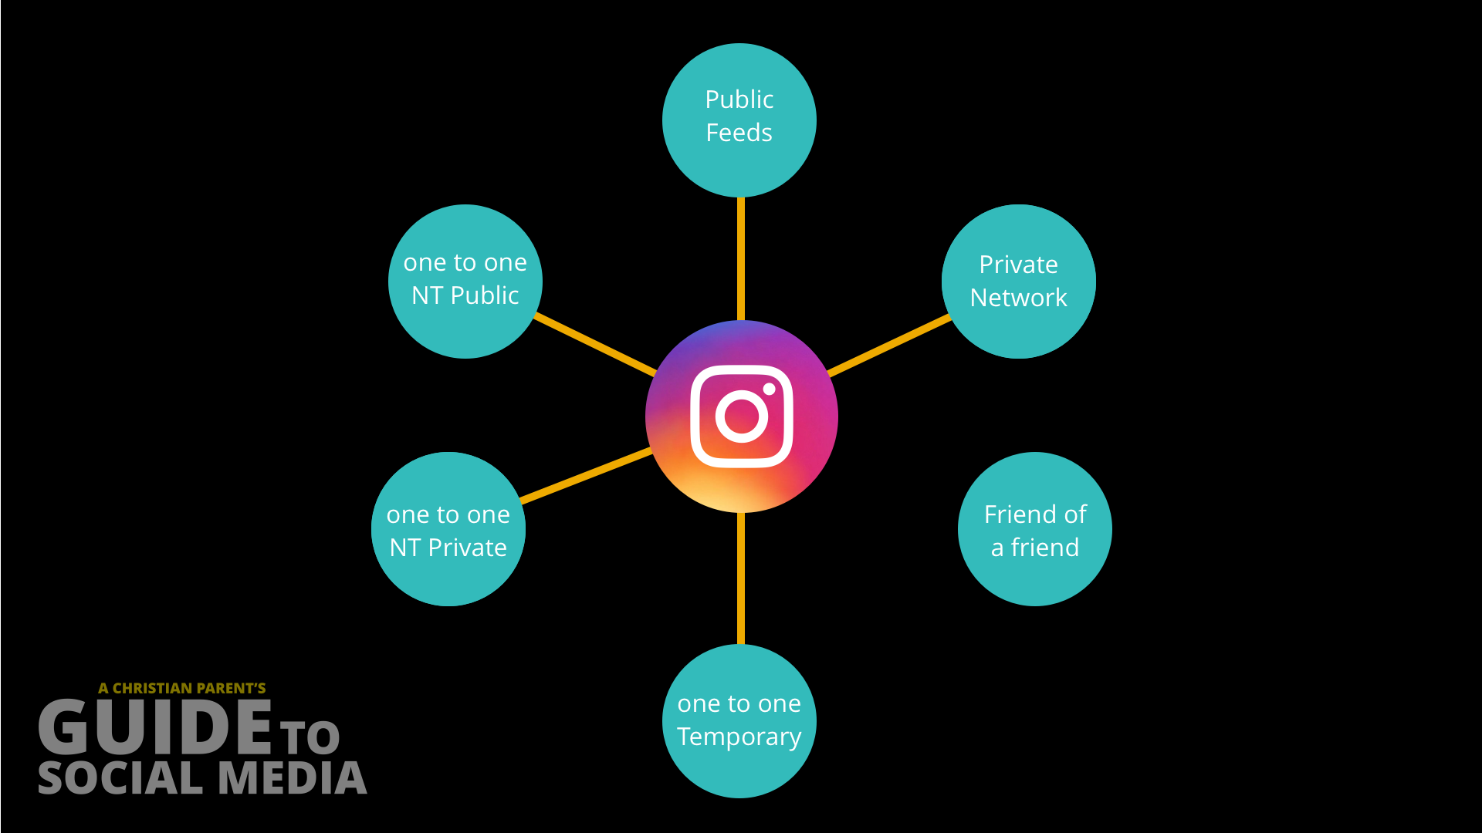
Receiving
Content

Slide 44

Receiving
Content

Slide 45

Receiving
Content

Slide 46
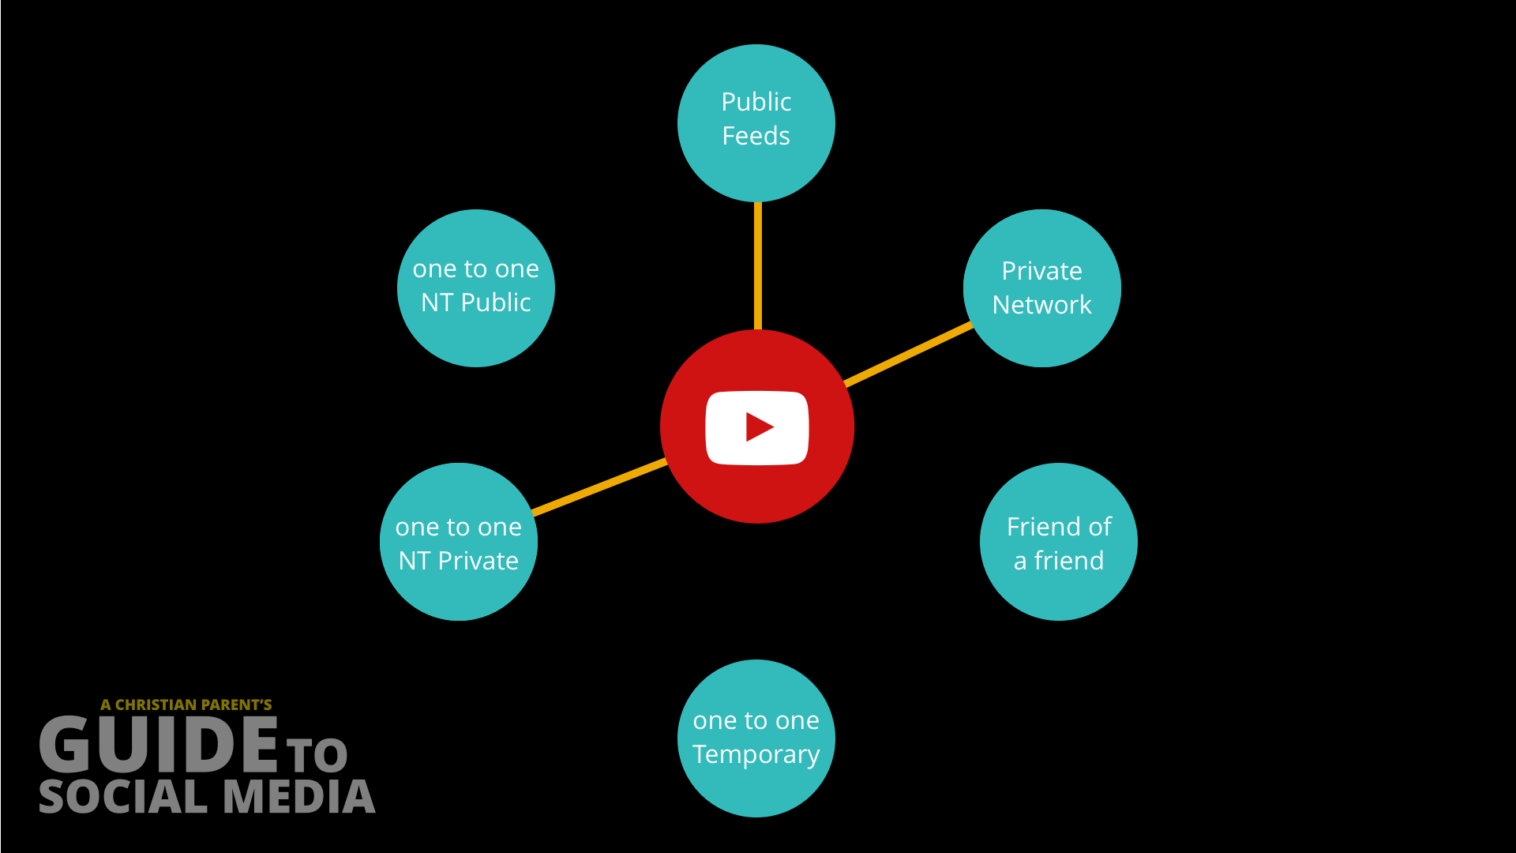
Receiving
Content

Slide 47
What ways can you receive content?
 | Ways to receive content |  |  |  | 1 - 1 NON-TEMP
 | PUB FEEDS | PRI NET | FR of FR | 1 - 1 TEMP | PRI NET | PUB NET
Facebook | X | X | X |  | X | X
Instagram | X | X |  | X | X | X
Snapchat | X | X |  | X
YouTube | X | X |  |  | X
Twitter | X | X | X |  | X | X
Periscope | X | X
Pintrerest | X | X |  |  | X
Houseparty |  | X |  | X
Texting |  | X |  |  | X
FaceTime |  |  |  |  | X
WhatsApp |  | X |  |  | X
Duo |  | X |  |  | X
Skype |  | X |  |  | X
Hangouts | X | X |  |  | X

Slide 48
Best Practices

Slide 49
Internet Safety
Contract

Slide 50
…for example
I agree to use only social networks that are first approved by my parent/guardian.
I agree to only add people to my social network friend/contact lists that have been approved by my parent/guardian.
I agree to allow my parent/guardian to review the security settings of all of my social network accounts.

Slide 51
…more Best Practices
Keep computers in public locations
Charge mobile devices outside of bedrooms
Parents have the login information to all accounts
Monitor your children’s accounts, review their social connections and friend/follow them
Manage security settings on each account

Slide 52
…more Best Practices
Be aware of their behaviors
Have similar expectations as you would in the real world
Inappropriate language in sharing or receiving content
Bullying or being bullied
Quickly changing their behavior when you come near

Slide 53
Internet Safety
Software Tools

Slide 54

www.x3watch.com

Slide 55

www.covenanteyes.com

Slide 56
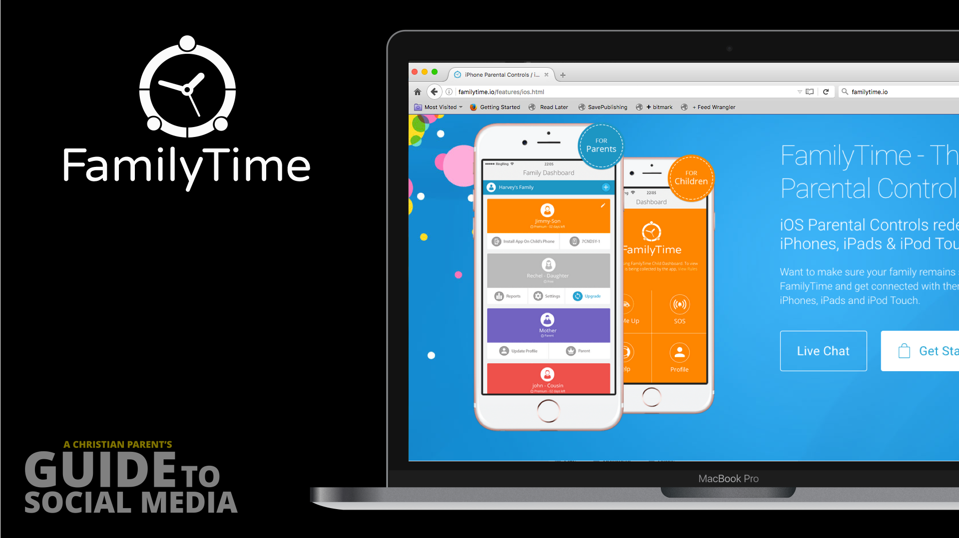
www.familytime.io

Slide 57
…some other options
Norton Family Premier
PhoneSherif
Eset Parental Control
Qustodio for Families Premium
Tom’s Guide: http://bit.ly/guide-apps

Slide 58
http://guide.andysmith.ca
Online Resources, Downloads & Links
Follow me on Instagram or Twitter
@youthpoint

Slide 59

Looking for a great adventure for your children this summer?
Check out
Medeba
Medeba.com
Yes, this is a shameless plug…

Slide 60
Questions &
Answers

Slide 62
Thanks…

